Slide 1
Networks Introduction
Modeling practical lab 2

Slide 2
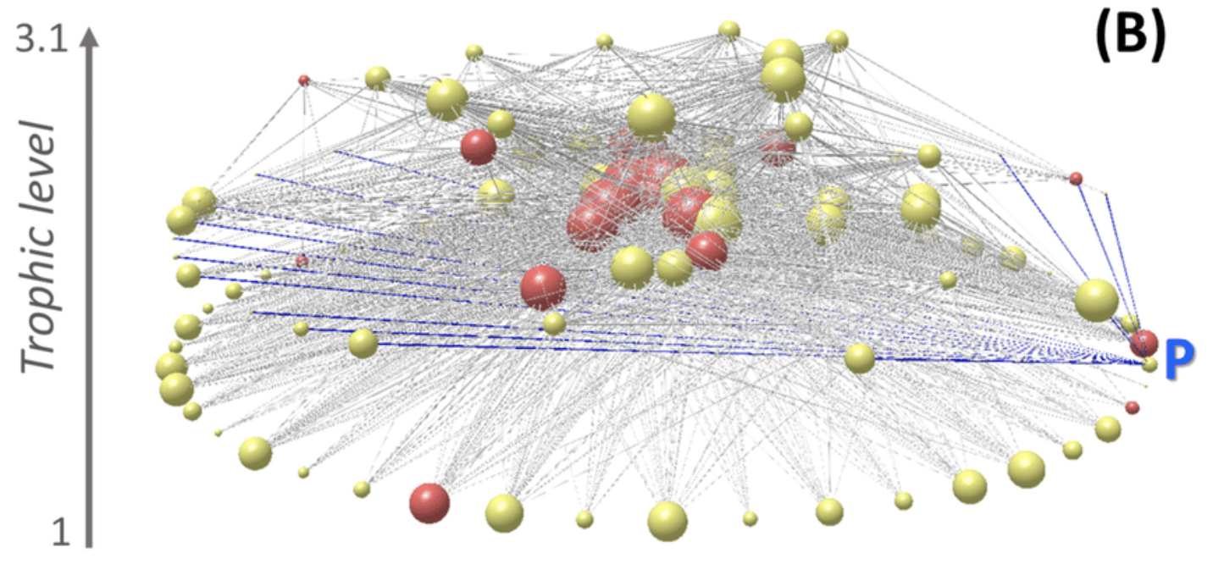
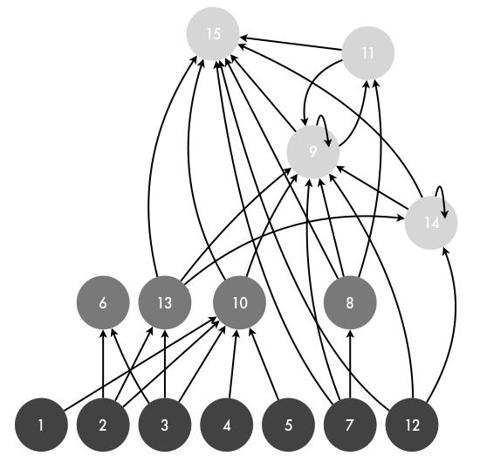
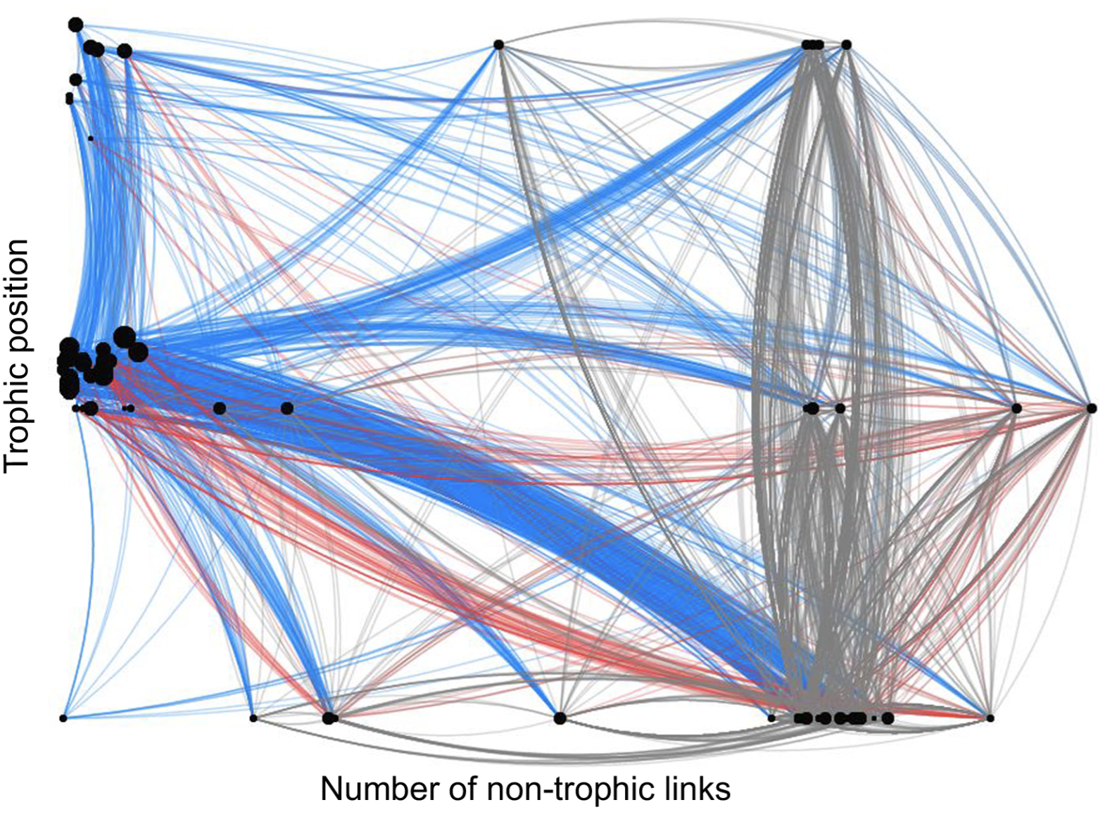
The networks we may be used to seeing… (graphical)

Slide 3
Understanding graphical networks
consumer/predator
Energy flows from the beginning of the arrow (starting at the resource) to the end of the arrow’s point (ending at the consumer)
Questions?
resource/prey

Slide 4
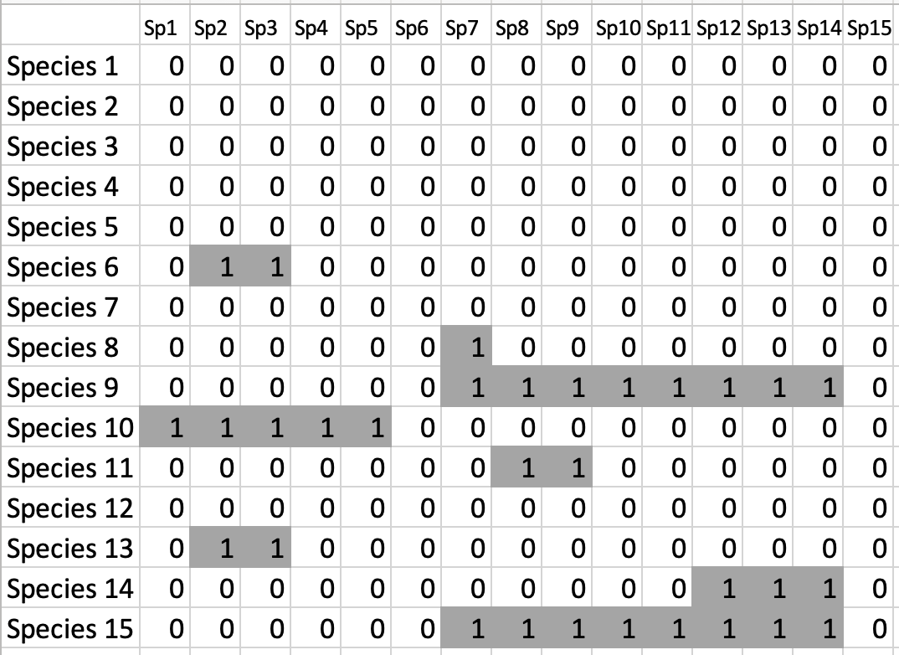
Conversion between Graphical and Matrix forms
Matrix form is used in the code

Slide 5
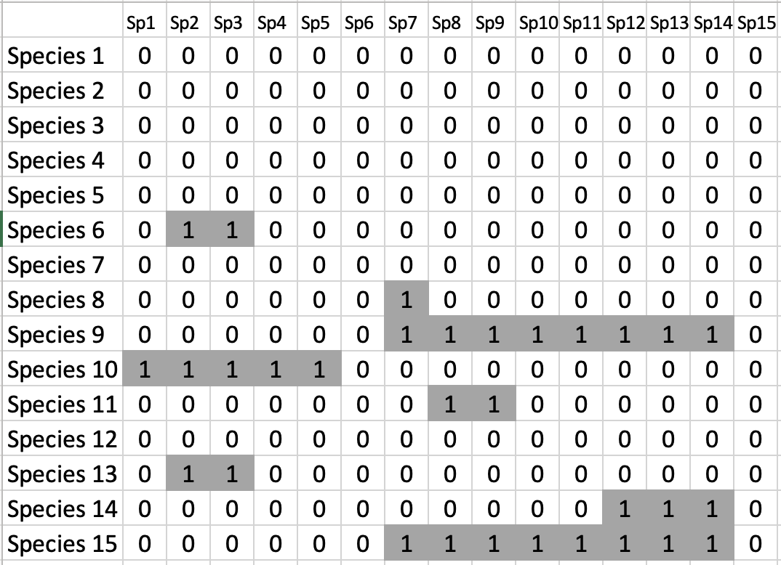
Each species, x, has a row and column

Slide 6
Row = resources of species x
ROWS, RESOURCES BOTH START WITH THE LETTER R ☺

Slide 7
Column = consumers of species x
COLUMNS, CONSUMERS BOTH START WITH THE LETTER C ☺

